Slide 1

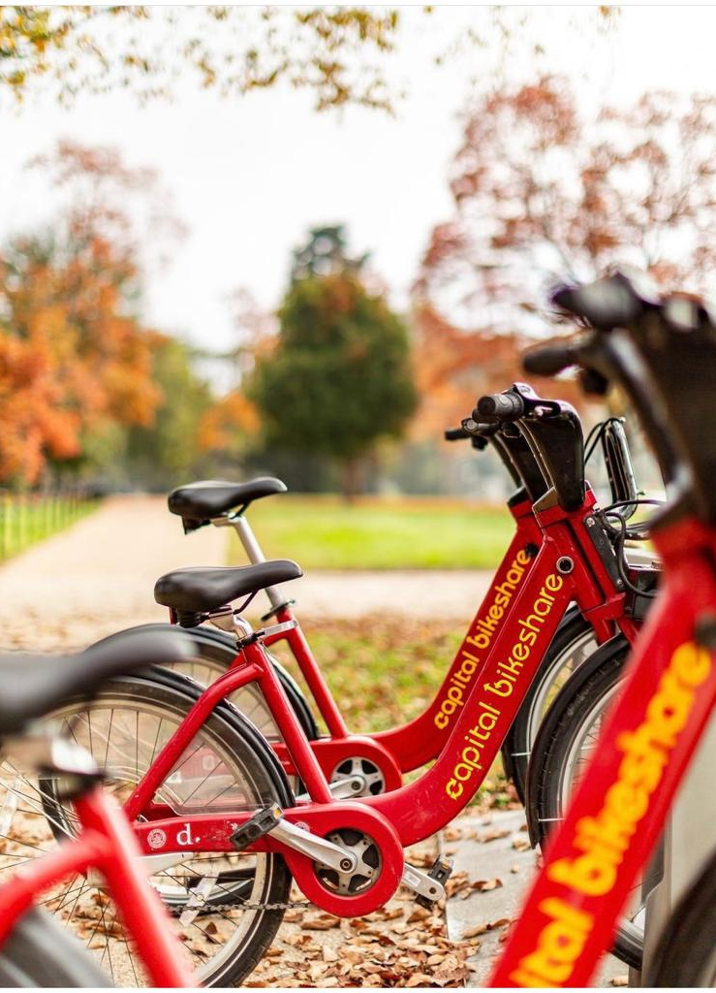

GHASSAN ALREHAILI
MAHA ALHARQAN
FAISAL ALJOWAIE
INTERNS AT SDAIA BOOTCAMP T5
REGRESSION MODEL

Slide 2
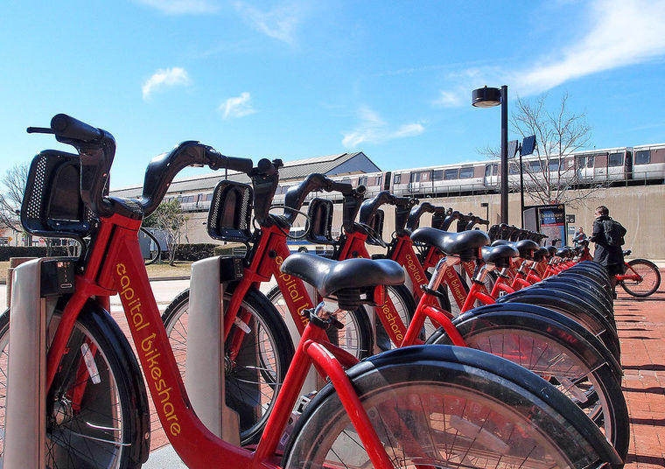
Today's Topics
OUR DISCUSSION FLOW
- Capital Bikeshare Overview
- About Dataset
- Questions
- Algorithms
- Conclusions
- Tools

Slide 3
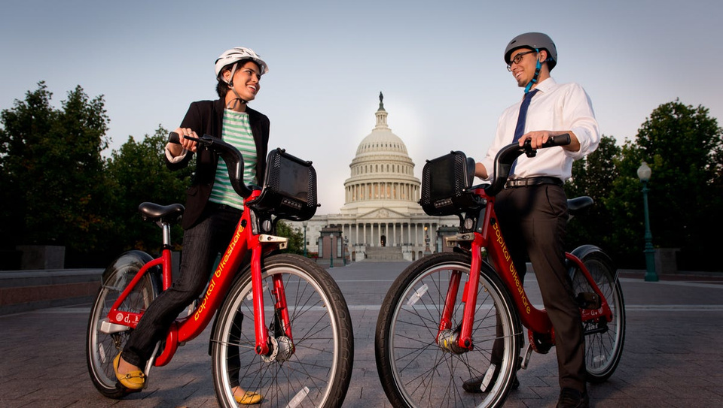
Capital Bikeshare Overview
- Capital Bikeshare (also abbreviated CaBi) is a bicycle-sharing system which serves Washington .
- Opened in September 2010, the system was the largest bike sharing service in the United States

Slide 4
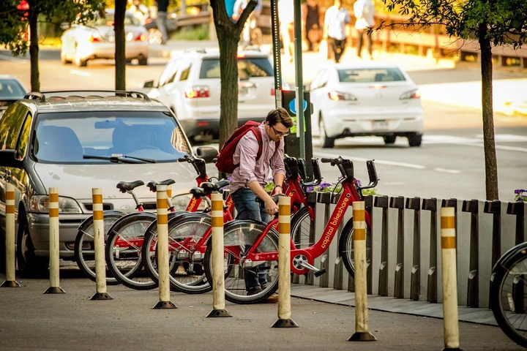
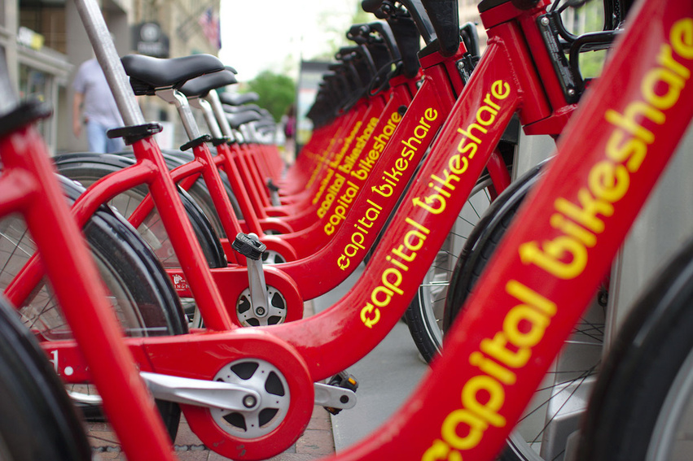
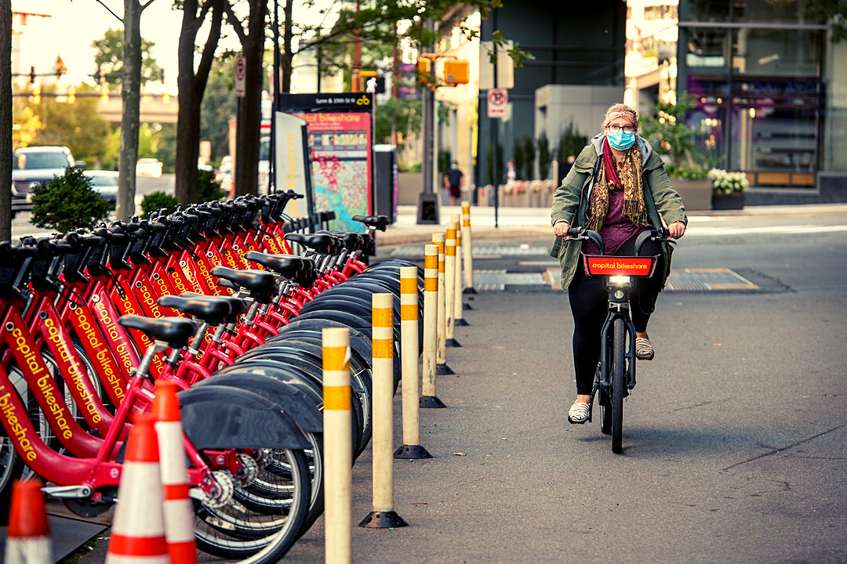
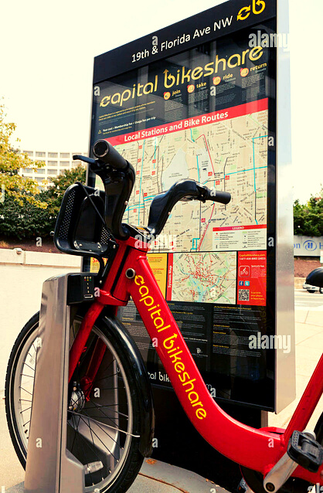
Capital Bikeshare Overview
- In April 2011, it had 11,000 members and 1,100 bikes in circulation.
- In September 2011, Capital Bikeshare announced it had reached 18,000 members and one million rides in its first year of operation, doubling initial expectations.
-As of May 2021, it had 627 stations and 5,400+ bicycles.

Slide 5


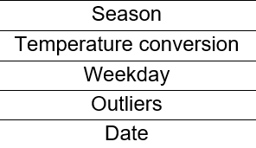

Dataset
17,379 ROWS, 14 COLUMNS.

Slide 6

Common questions
WHAT ARE THE MOST CROWDED DAYS AND WHAT TIME WAS IT?
WHAT IS THE DIFFERENCE BETWEEN REGISTERED AND CASUAL USERS?
HOW DOES THE SEASON AFFECT THE NUMBER OF USERS?
DID THE LOW TEMPERATURE IN WINTER AFFECT THE REGISTERED USERS AND CASUAL USERS?
Predict the total users that depends on time .

Slide 7
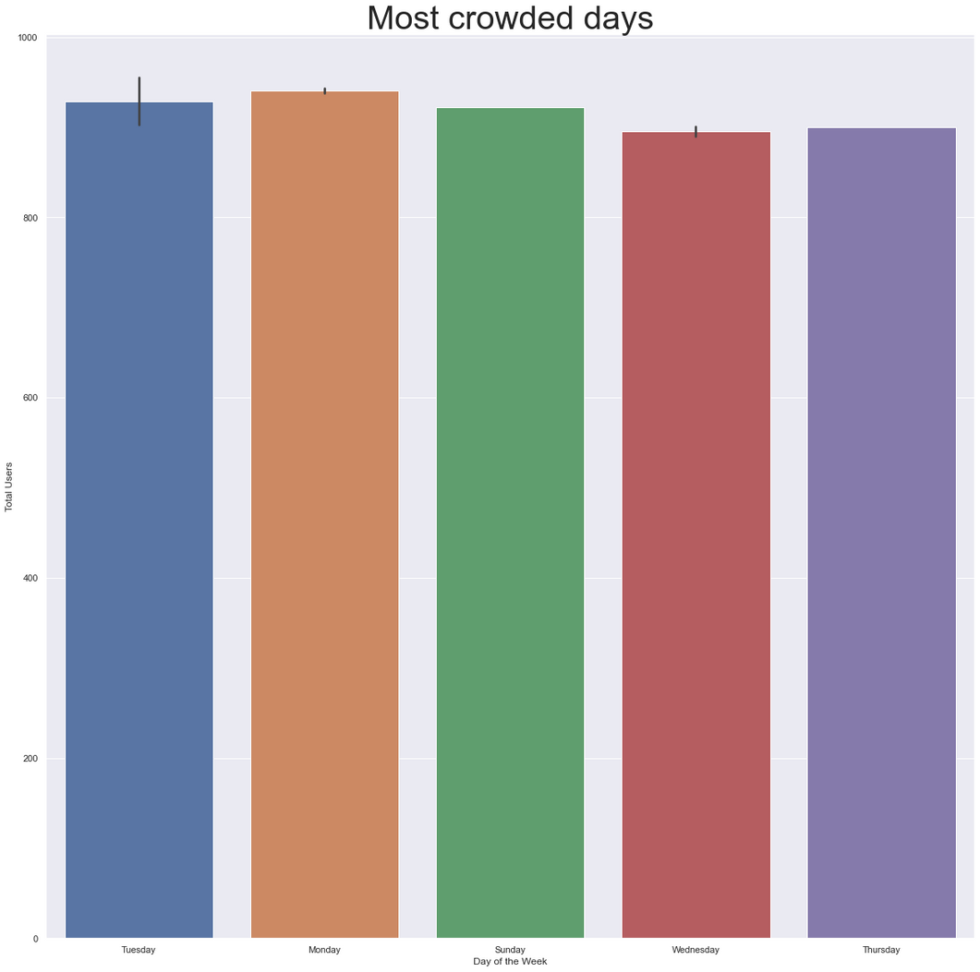
What are the most crowded days and
what time was it ?

Slide 8
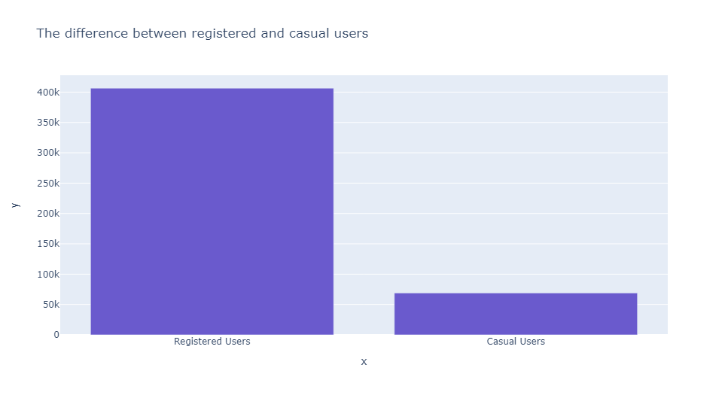
What is the difference between registered and casual users?

Slide 9

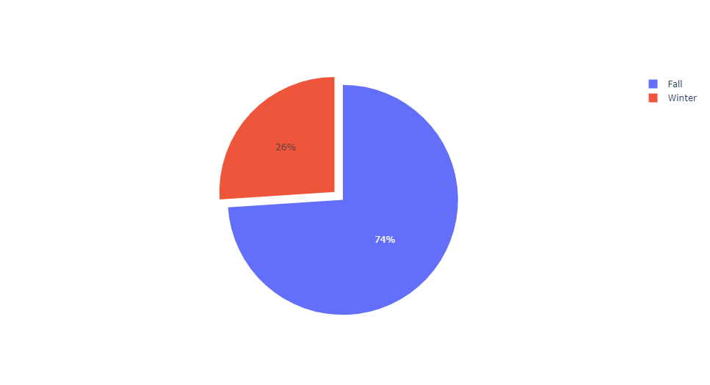
How does the season affect the number of users?

Slide 10
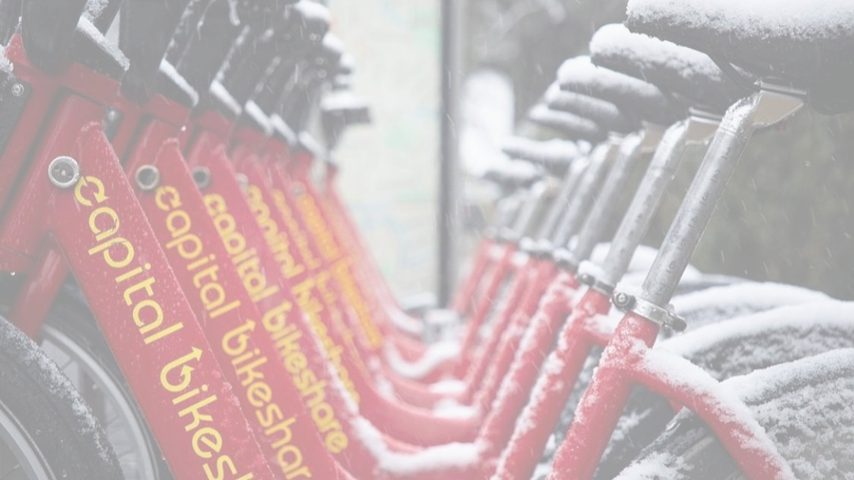
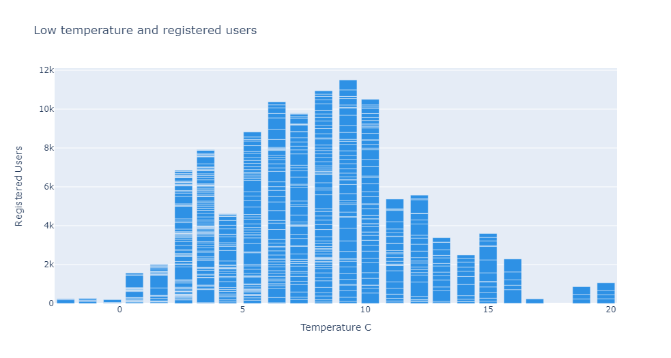
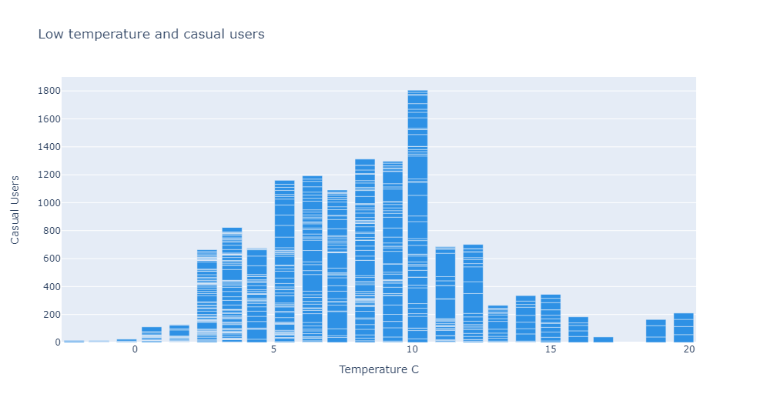
DID THE LOW TEMPERATURE IN WINTER AFFECT THE REGISTERED USERS AND CASUAL USERS?

Slide 11
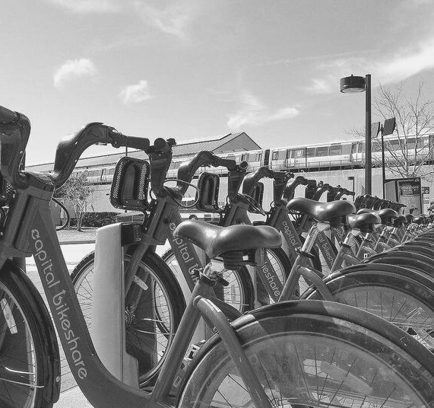
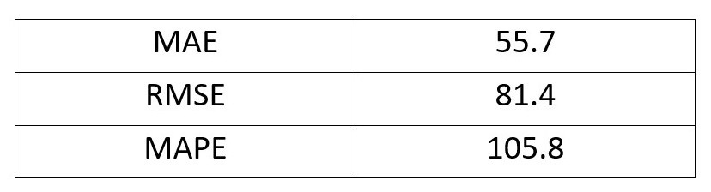
PREDICT THE TOTAL USERS THAT DEPENDS ON TIME .

Slide 12
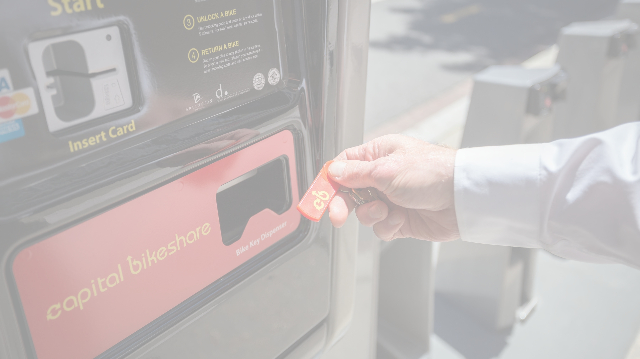

CONCLUSIONS
WAYS TO STABILIZE / INCREASE THE NUMBER OF REGISTERED USERS
DEALING WITH EXTERNAL FACTORS AFFECTING THE NUMBER OF USERS

Slide 13










Tools

Slide 14
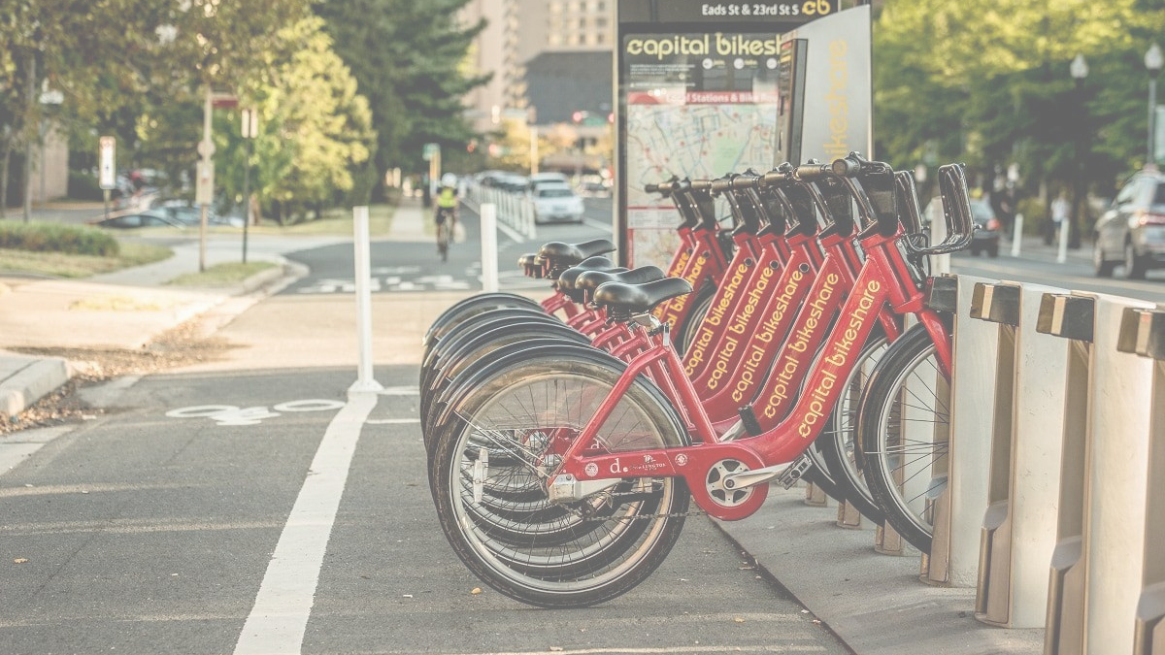
Thank
you!

